Slide 1
What's new and what's next in SharePoint Development for Enterprise & SPFx

Slide 2

What's new and what's next in SharePoint Development for Enterprise & SPFx ?
Disclaimer : We would be talking only about the cloud world in this session .
By ,
Vignesh Ganesan – Technical Specialist , Microsoft India
Vijai Anand Ramalingam – Tech Architect , Cognizant
Global Microsoft 365 Developer Bootcamp – Bengaluru
Nov 16th , 2019

Slide 3

About Myself
Technical Specialist , Modern Workplace – Microsoft
Blogger on Vignesh’s SharePoint Thoughts , European SharePoint Community , Collab 365 , C Sharp Corner, Collab 365 & HubFly Blog site
Spoken on plethora of webinars and couple of conferences /Local User groups
Chapter Lead for C Sharp Corner Bangalore Chapter and an ambassador for aOS Community
C Sharp corner MVP /Completed 10+MS Certifications

Slide 4

My co-speaker today
Vijai Anand Ramalingam: Modern Workplace Architect , SharePoint/Office 365 – Cognizant.
Microsoft MVP/C# Corner MVP
Blogger, Author and Speaker
1200 blogs, 7 books, spoken on 4 SharePoint Saturday Events, Microsoft Ignite, Insider Dev Tour, C# Corner Webinars and Azure Vidyapeeth

Slide 5

What to expect from today’s session
What’s new in SP Dev & SPFx ?
Release notes & latest updates
Some cool demos
What is SPFx ?
Roadmap

Slide 6

Microsoft 365 App Foundation
Content
Pages & Sites
Office Apps and OneDrive
SharePoint
Email and Calendar
Teamwork
People & Teams
Outlook
Microsoft Teams
Microsoft Graph
Microsoft Identity
App Experiences
Processes
Windows 10
Flow and Planner
App Elements
Lists, Search & App Hosting in SharePoint
Notes:
Objective: Reinforce our teamwork position - Microsoft 365 meets the diverse needs of teams with an integrated solution that is secure
We’ve designed Microsoft 365 to meet the unique needs of every group.
For each of those categories of teamwork, Microsoft 365 includes a purpose-built application.
Teams as a hub for teamwork where groups that actively engage and are working on core projects can connect and collaborate
Yammer for people to connect across their company, sharing ideas on common topics of interest
Outlook where teams can communicate in a familiar place, and can easily create modern distribution list with groups in Outlook
SharePoint for keeping content at the center of teamwork, making files, sites and all types of content easily shareable and accessible across teams
Office Apps – enabling co-authoring in familiar apps like Word, Excel, and PowerPoint
With these tools coming together in Microsoft 365 – teams get a holistic solution.
What’s unique about teamwork in Microsoft 365 is that all of these applications are built on an intelligent fabric - suite-wide membership service with O365 Groups; suite-wide discovery and intelligence with Microsoft Graph, and suite-wide security and compliance.
Office 365 Groups - A membership service providing a single identity for teams across Office applications and services
Microsoft Graph - Suite-wide intelligence that maps the connection of people and content to surface insights
Security and Compliance - Proactive security that simplifies IT management with intelligence built-in

Slide 7

1 billion
1 million
100 billion
users across work, life and edu
monthly active apps using Microsoft Identity
Microsoft Graph requests per month
Your tailored experiences or customizations
18 trillion
90%
180 million
Microsoft Graph nodes
Fortune 500
monthly active users of Office 365 commercial

Slide 8
Microsoft Graph
SharePoint Framework growth
2x users every 90 days
SPFx Extension header
Web parts
Page visuals UI Fabric
7 major SPFx updates since GA
SPFx Extension footer

Slide 9
Microsoft Graph
SharePoint Framework growth
236% usage since last year
SPFx Extension header
Web parts
Page visuals UI Fabric
11 major SPFx updates since GA
SPFx Extension footer
Notes:
2169917126 to

Slide 10

>500 samples
>1000
awarded
for helping to learn to extend Microsoft 365
Contributors in GitHub organizations
Internally at Microsoft as the reference model for community engagement
aka.ms/sppnp
>60000
>28000
>2.4 million
Visitors in GitHub organizations in past 2 weeks
Tenants using open-source components each month
Watch time minutes in the YouTube channel within last 365 days
fefe

Slide 11
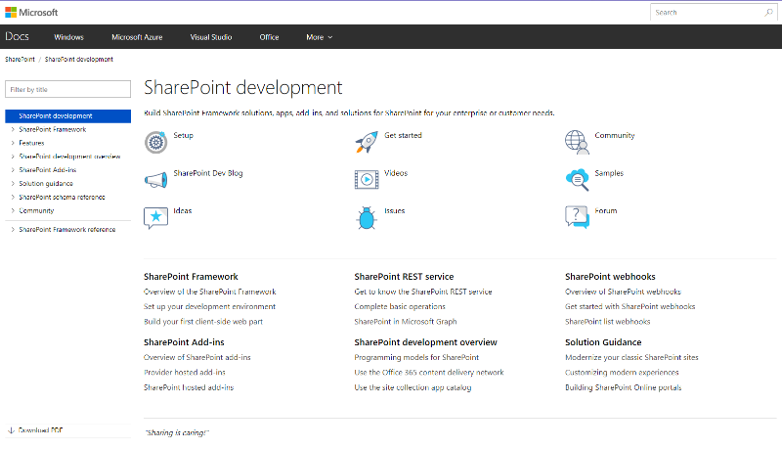
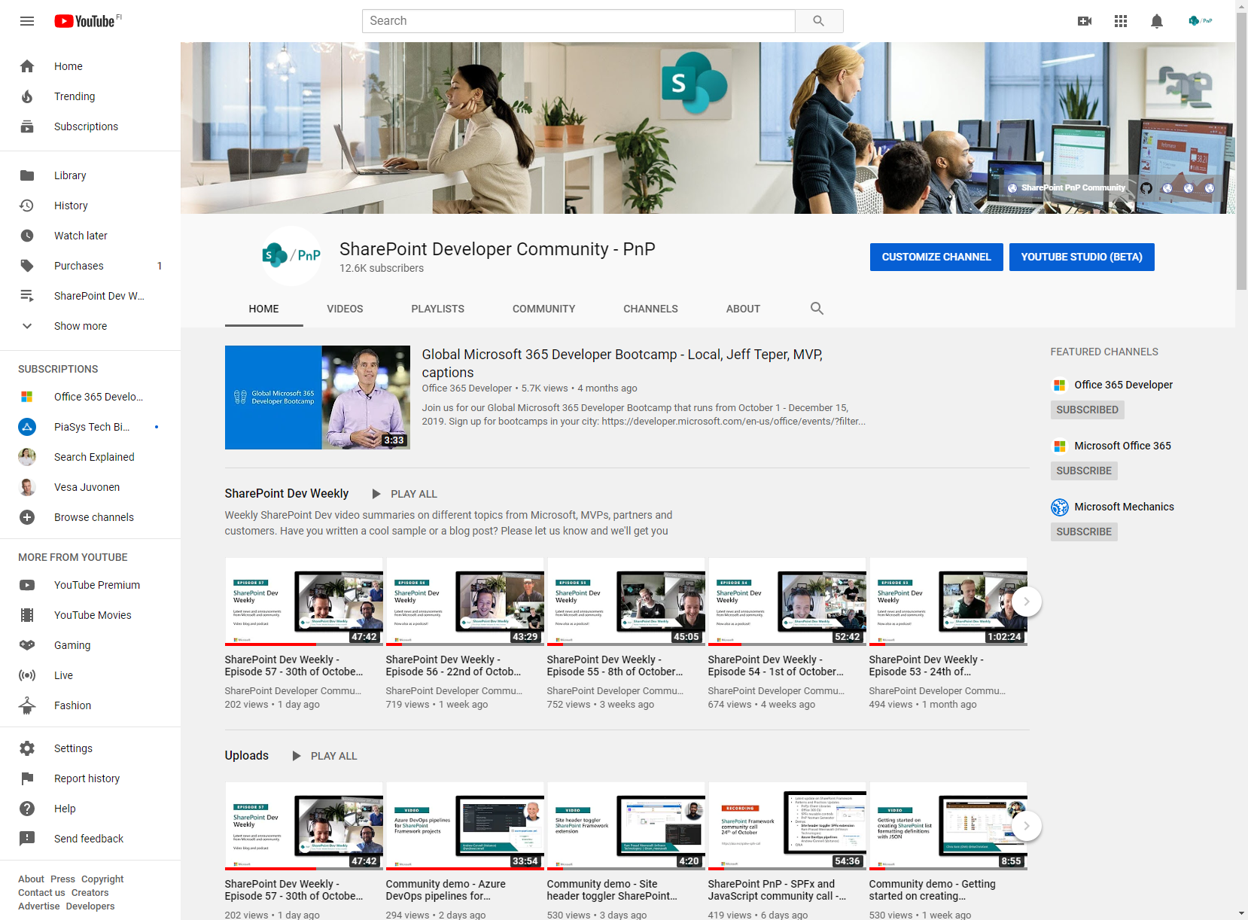
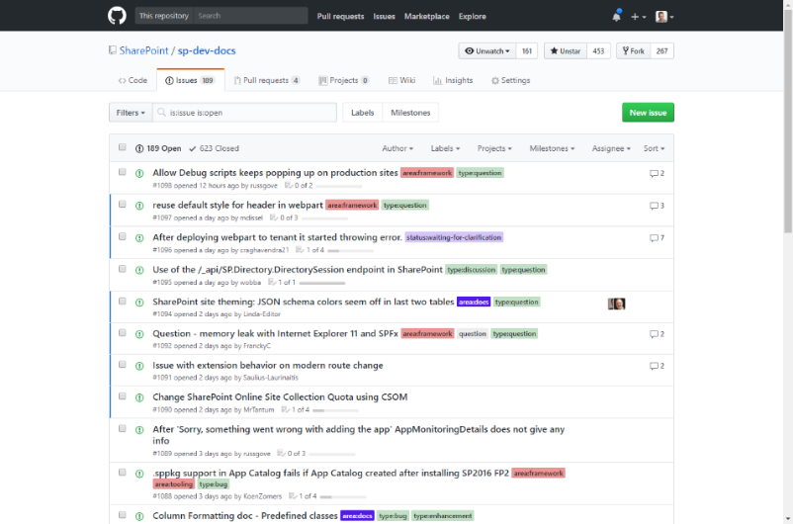
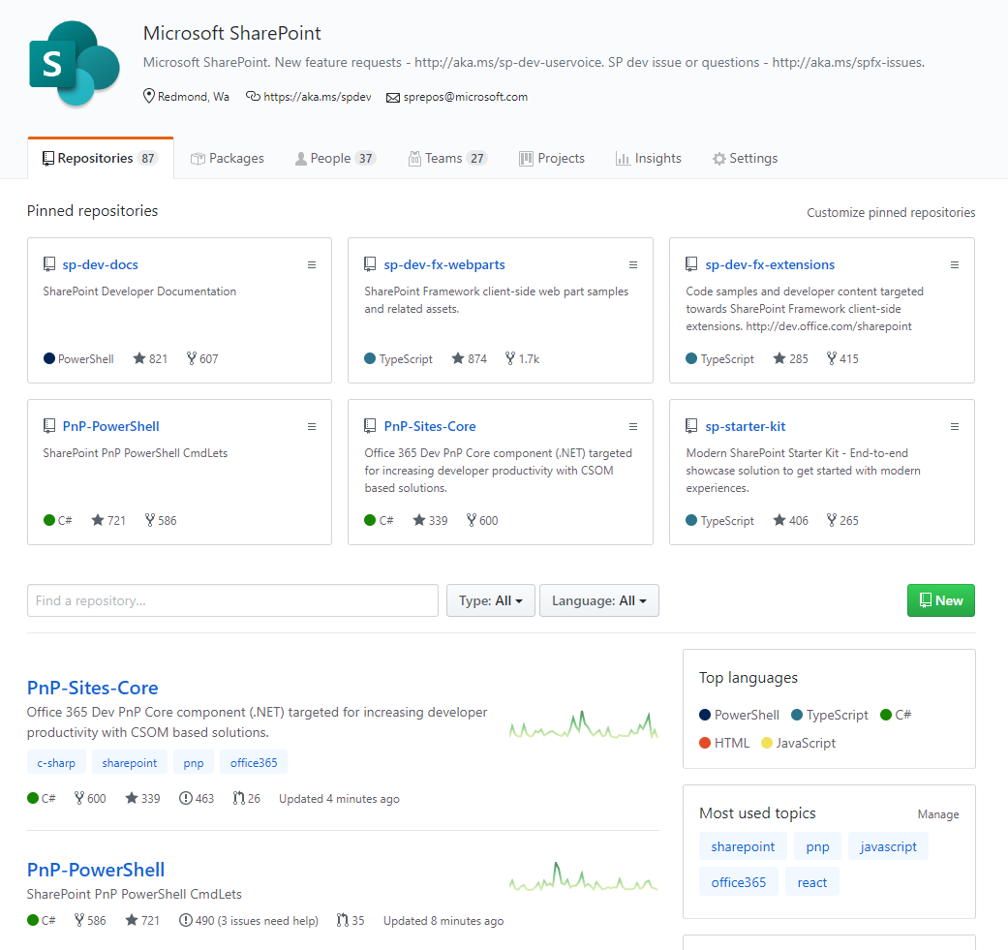
SharePoint Dev docs
SharePoint (Dev) videos
SharePoint Dev issues
Open-source
aka.ms/spdev-docs
aka.ms/spdev-videos
aka.ms/spdev-issues
github.com/sharepoint
github.com/pnp

Slide 12
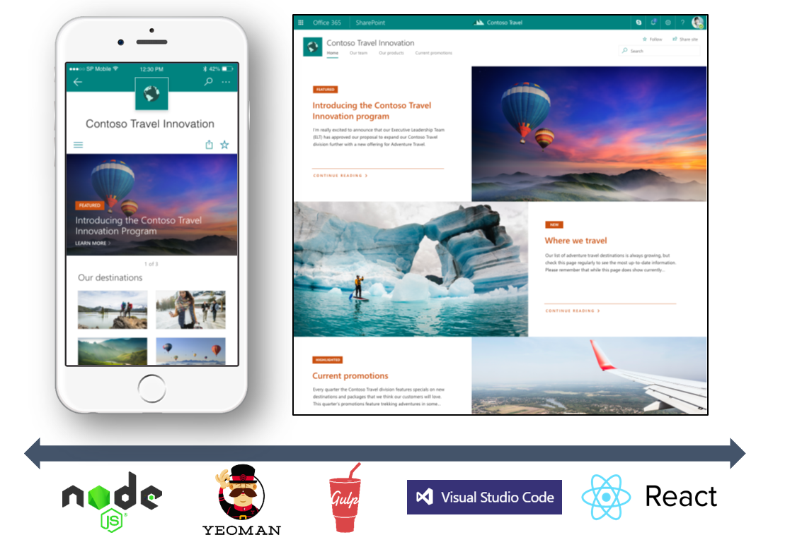
SharePoint Framework (SPFx)
Modern client-side development
Lightweight web and mobile
Powers our own experiences
Backward compatible
Supports open source tools and JavaScript web frameworks
SharePoint Framework
http://aka.ms/spfx-training
Microsoft Graph
LOB Systems and Cloud Services

Slide 13
SharePoint Framework Architecture
Developer Toolchain
Solution Catalog
Boot Loader
Client Runtime
Integrated in Yeoman
IDE agnostic
Uses Node and NPM
For 3rd party components
Support ALM capabilities
REST APIs and UX
Hosted in SharePoint
Provides context
pre-fetch data
TypeScript libraries
Handles load
Handles execution
Authentication Pipeline
HttpClients
Contextual Information
Gives access to Web APIs
Serves AAD access tokens
Wraps to ADAL.js
Makes calls to SharePoint, Graph, AAD protected APIs and general Http requests
Information on things like the current user, site, page, web, teams channel, etc.

Slide 14
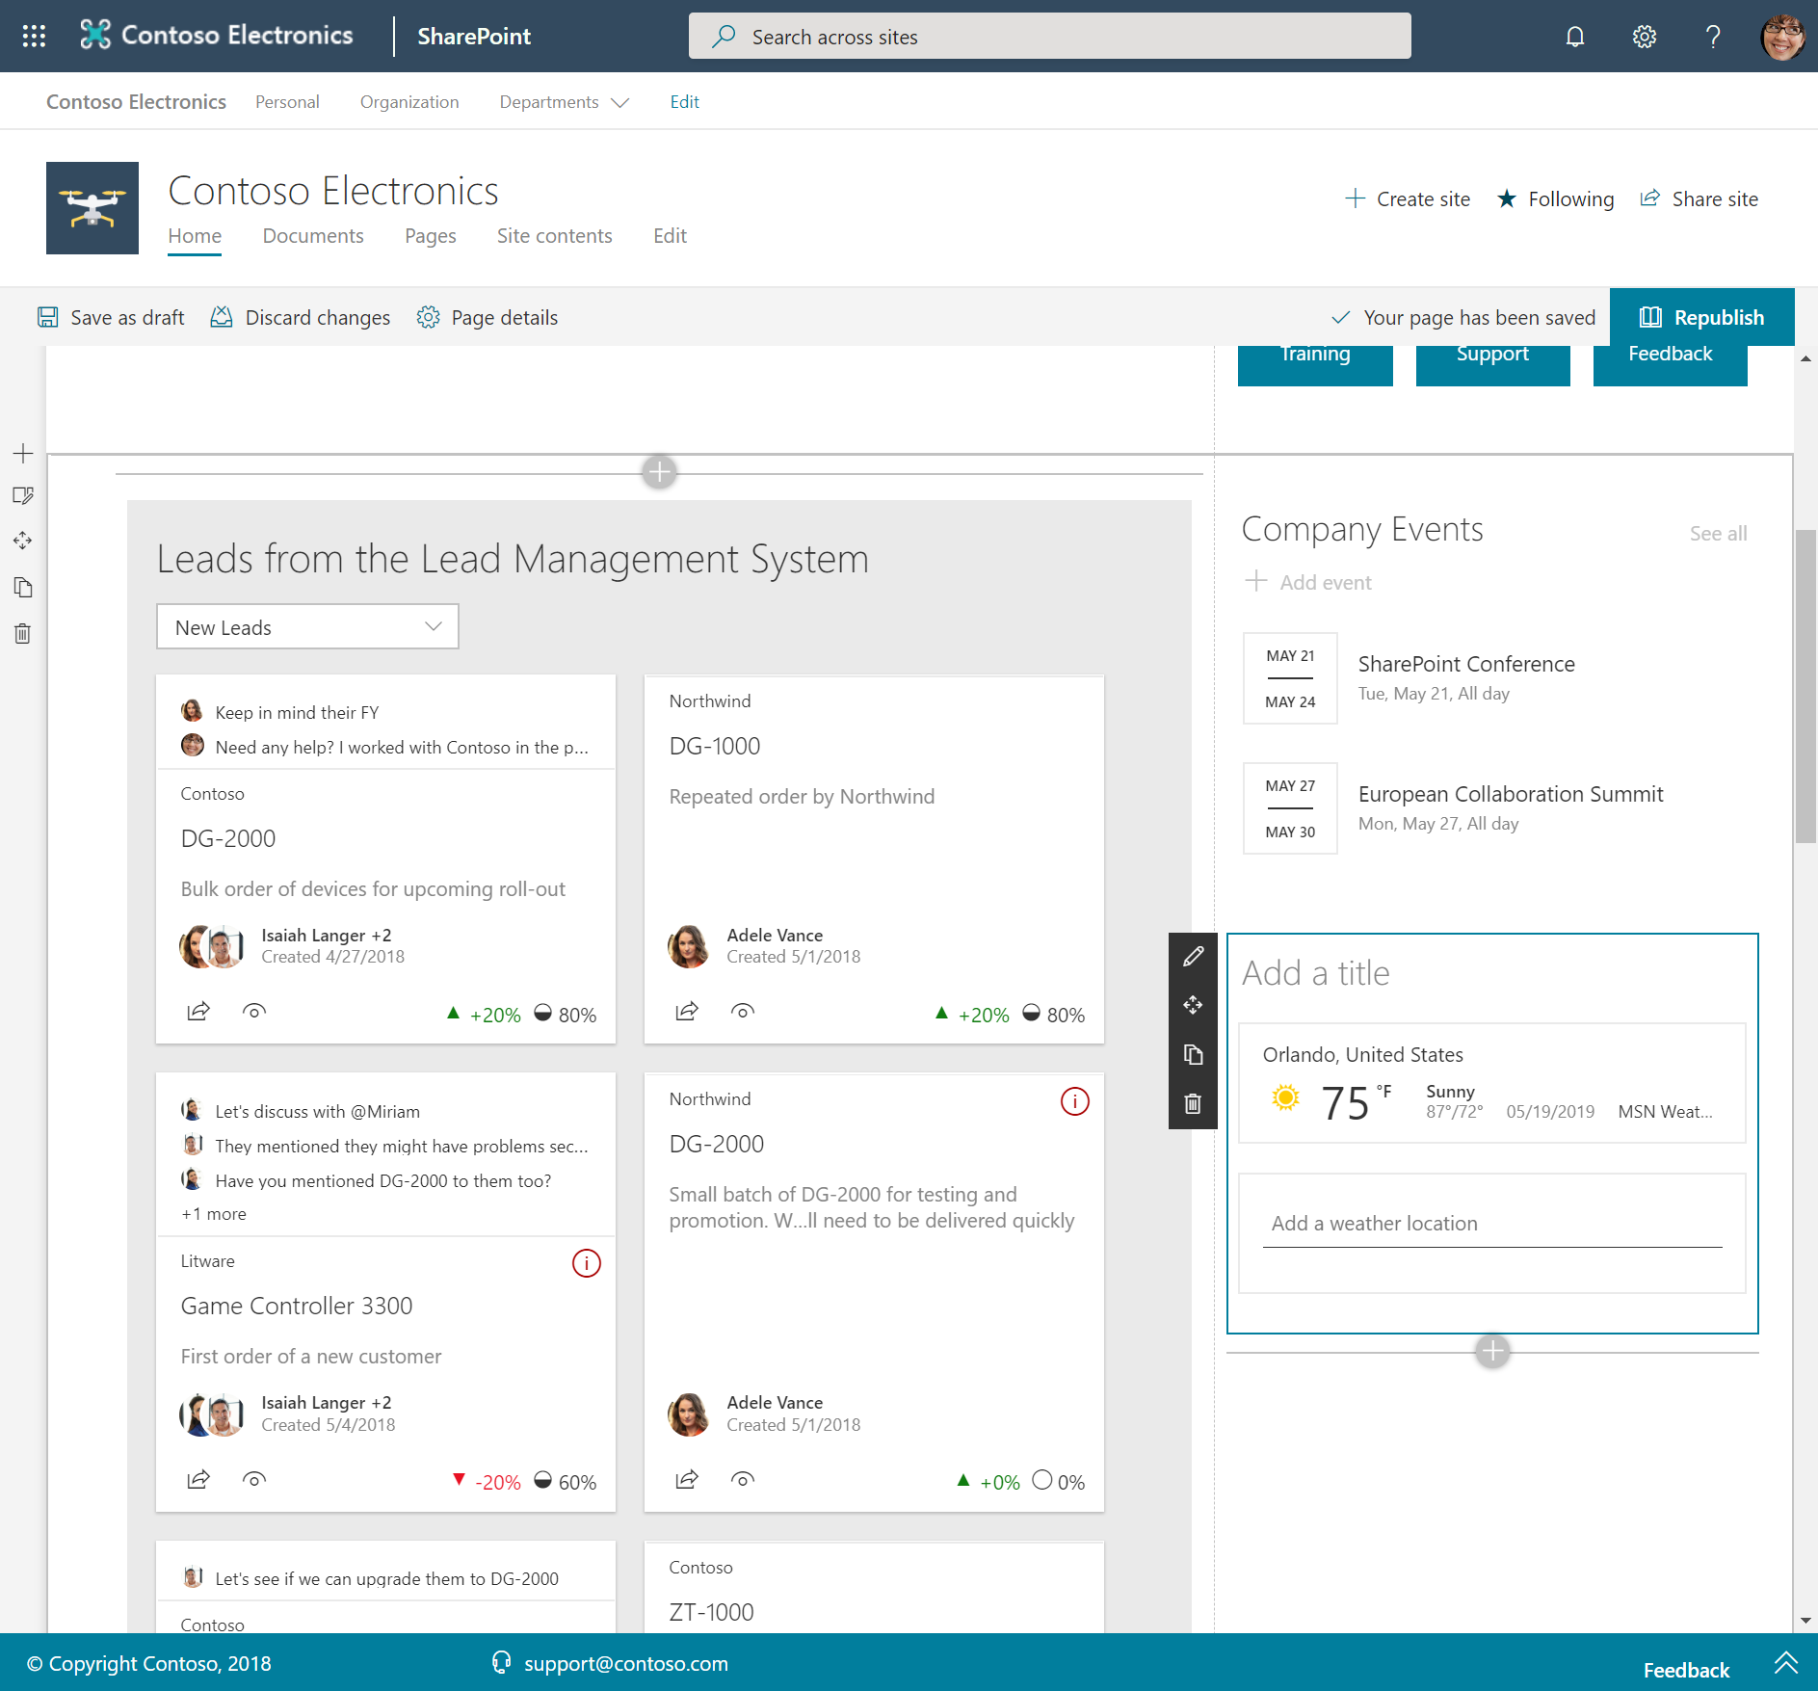
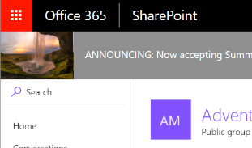
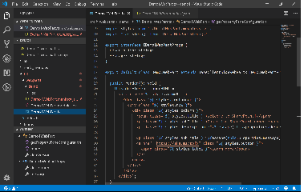
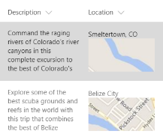
SPFx Component Types
Web Parts
Extensions
Libraries

Slide 15
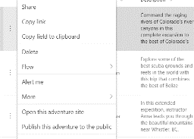
SharePoint Framework (SPFx) Extensions
Extend the user experience of SharePoint, leveraging the familiar tools and libraries for client-side development coming from the SharePoint Framework.
Application customizer
Command set
Field customizer
Add script to modern pages
Adjust top and bottom sections of page with custom renderings
Extend the modern list command surface with new actions that run custom code
Visualize data inside columns in the list view

Slide 16
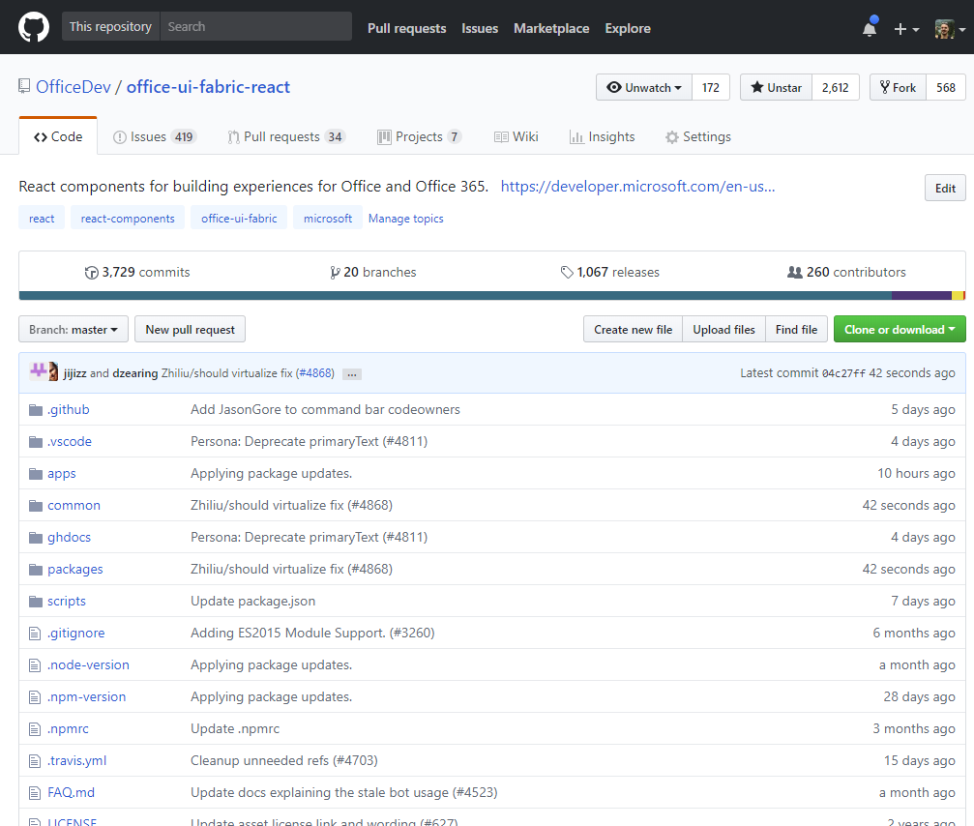
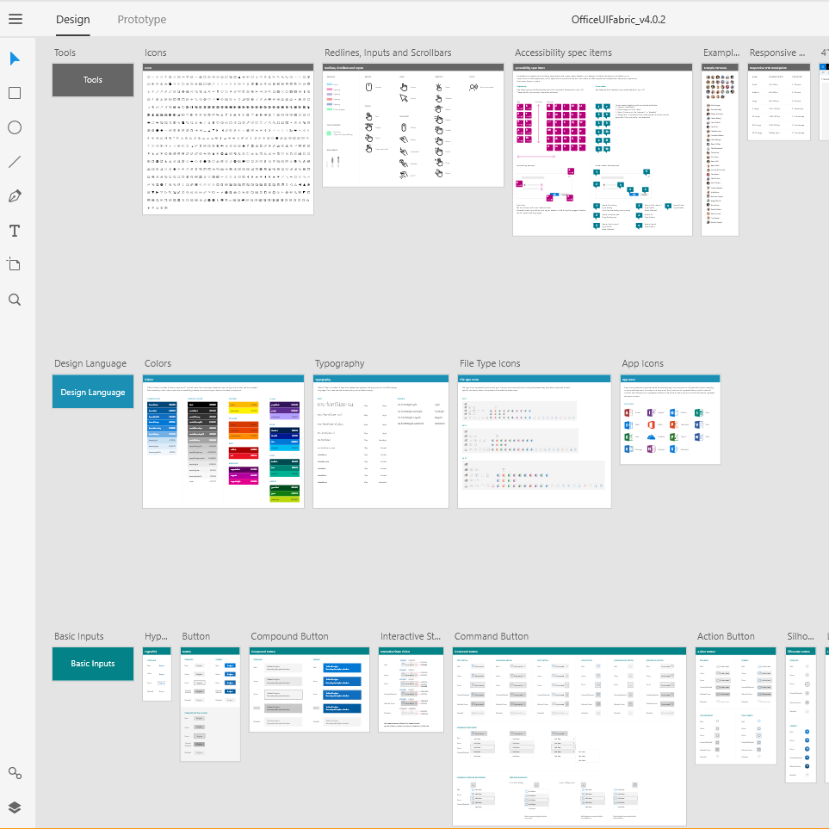
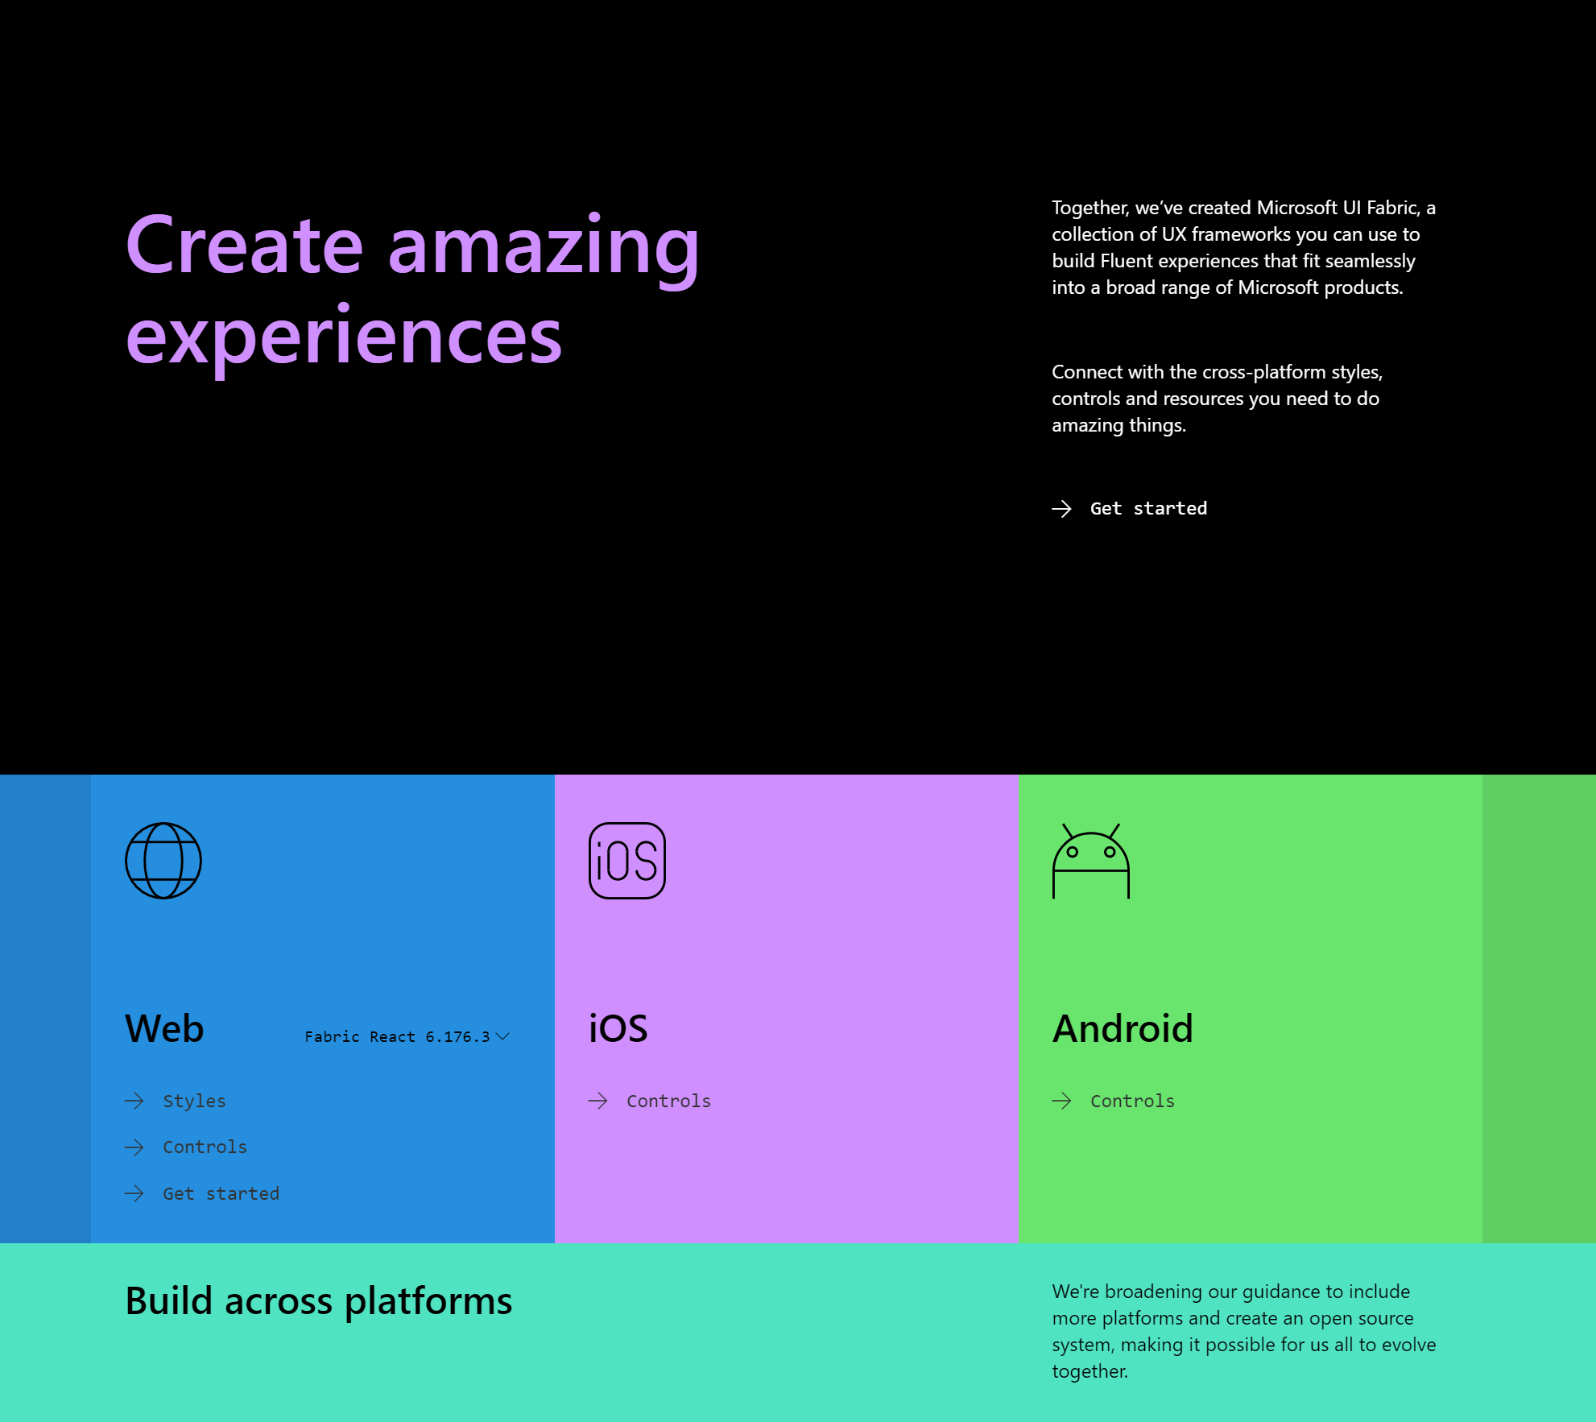
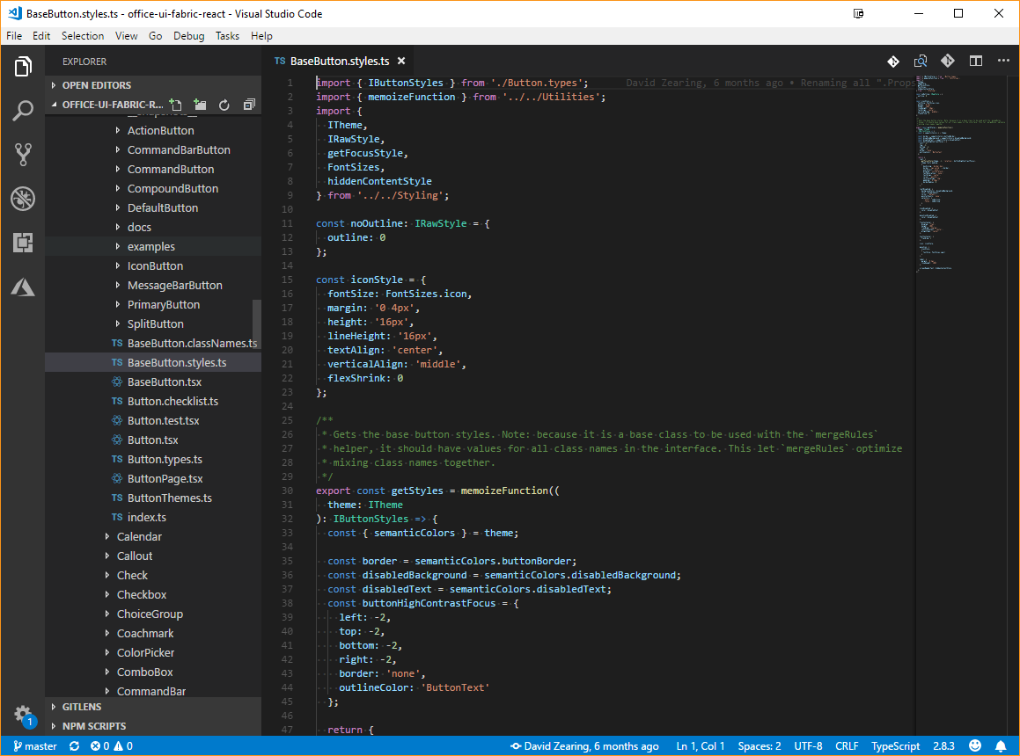
UI Fabric
Code for Developers
Fabric Core and Fabric React
Toolkits for Designers
Sketch/Figma
Documentation for Both
uifabric.io
Notes:
The React-based front-end framework for building experiences for Office and Office 365. Used across Office 365 . This repository contains the core styles used across all aspects of Fabric including icons, type, fonts, colors, the grid, etc.

Slide 17
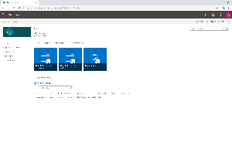
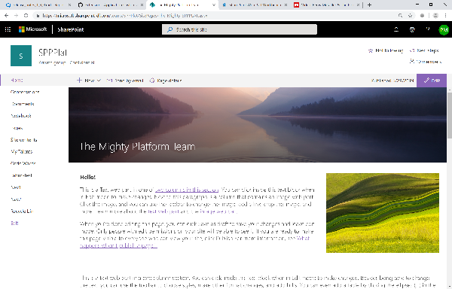
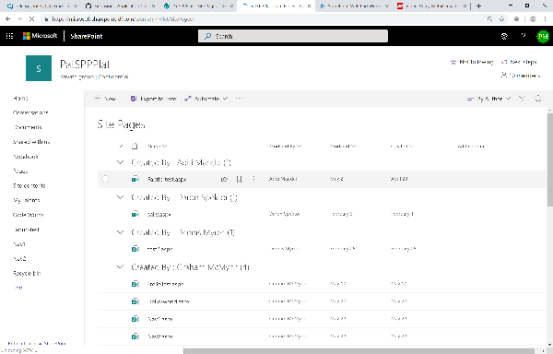
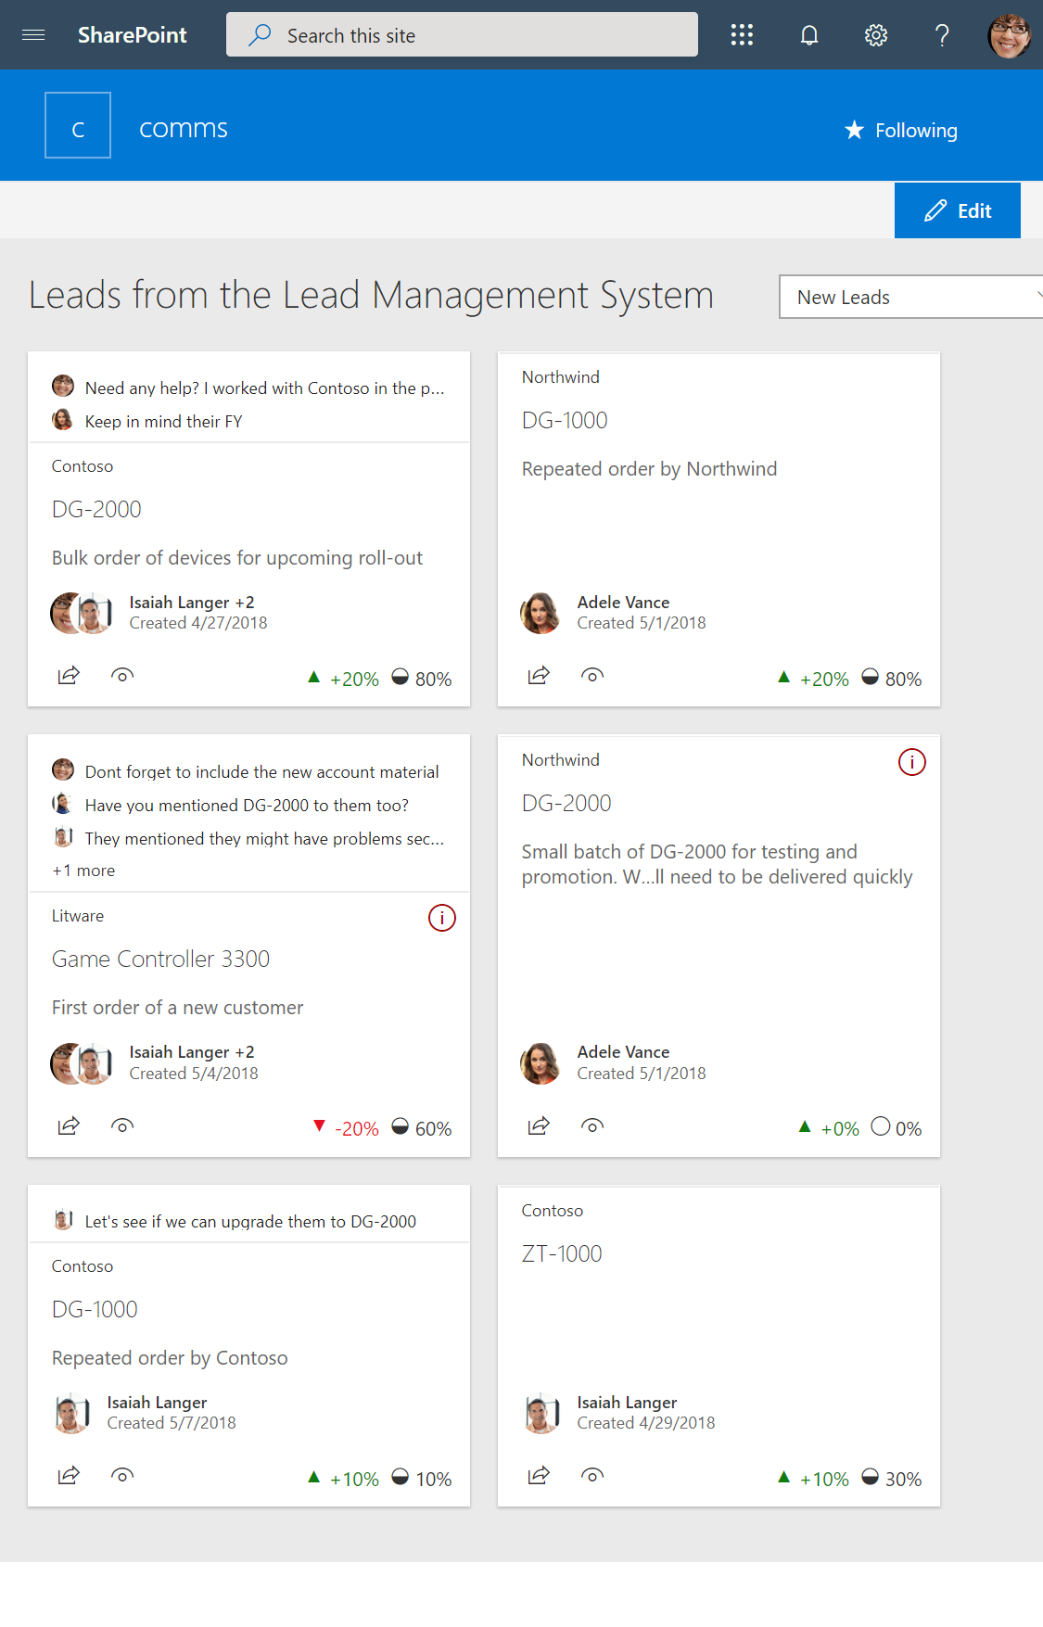
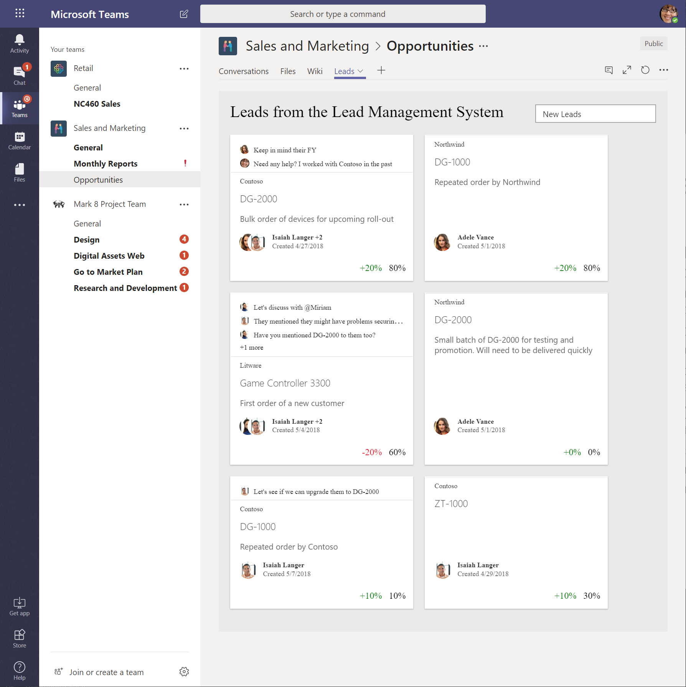
SPFx Hosted Scenarios
Classic Pages
Modern Pages
Lists and Libraries
App pages
Teams Tabs
Extensions
Extensions
Extensions
Web Parts
Web Parts
Web Parts
Web Parts

Slide 18
Release Notes
1.9.1 Release notes - 14th of August 2019
1.8 Release notes - 8th of March 2019
1.7 Release notes - 8th of November 2018
1.6 Release notes - 5th of September 2018
1.5.1 Release notes - 25th of June 2018
1.5 Release notes - 5th of June 2018
1.4.1 Release notes - 15th of February 2018
1.4 Release notes - 7th of December 2017
1.0 (GA) Release notes - 23rd of February 2017
Roadmap :_ https://docs.microsoft.com/en-us/sharepoint/dev/spfx/roadmap

Slide 19
SharePoint Framework Evolves Constantly
Web Parts
Extensions
Dynamic Data
Domain Isolated Web Parts
Support for section background styling
Dialog Framework
Tenant scope deployment
SharePoint 2019 support
Support for TypeScript 2.7, 2.9 and 3.x
App Pages
ALM APIs
Site collection app catalog
Support for Teams tabs
Security call 3rd party APIs secured with Azure AD
Native Graph API support
Office 365 CDN and automatic hosting
Tenant Wide Deployment of extensions
Library Components
Support for Teams Provider Hosted Solutions

Slide 20
SharePoint Framework Major Features v1.8 & v1.9.1
SPFx for Teams Tabs
Support for Section background styling
Full Page Single Web-part
Apps
Library Component
Domain Isolated Web Parts
Support for Teams Provider
Hosted Solutions
Notes:
WebParts
Extensions
Services available on all components
Life cycle events (onInit)
Context object (this.context.*)
Various HttpClients (SharePoint, Graph, AAD, Generic)
Service Scopes (a way to share services across components)
Dialog framework
Placeholders
Well known divs on a page that are reserved for 3rd party use
May or may not be present on a given page
May or may not be present on a given view (say mobile)
Available to any component (but often used in the Application Customizer Extension)
Placeholders != Extensions. There is no “Top” extension, but there is a “Top” placeholder
Default UX provided by framework, expandable by developer
Integrated in the Property Panel

Slide 21
App Pages
App pages
A Full Modern Page with preconfigured application content and no authoring experience – only optional configuration
Created as part of the “new page” flow or viewed using a query string driven _Layouts page.
Uses the same “chrome” as other pages in the site
Supports all the same extensions as authored pages

Slide 22
Demo
Full Page Single web-part (App Page) with SharePoint Framework

Slide 23
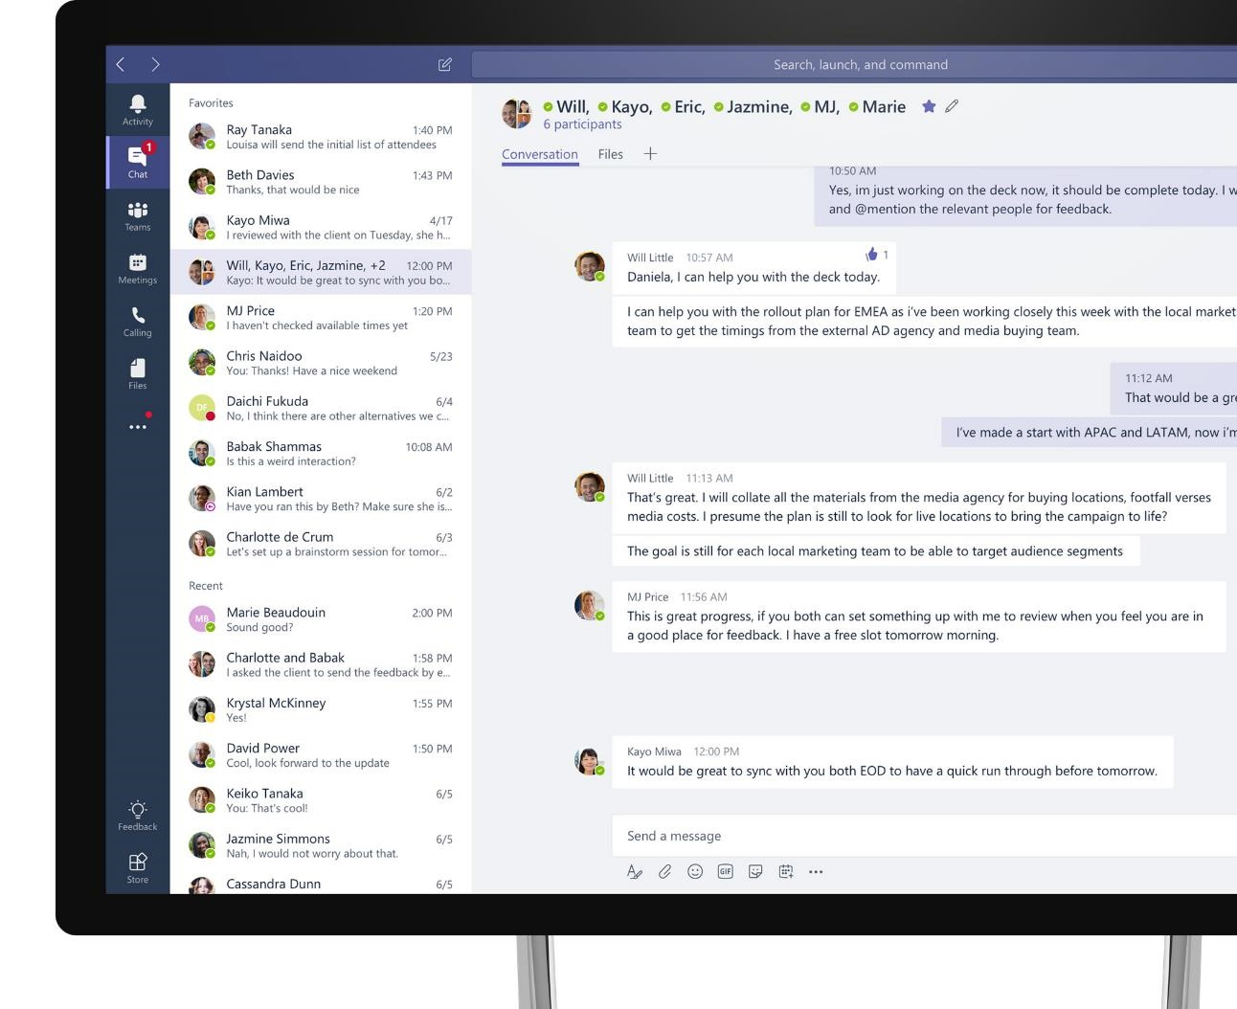
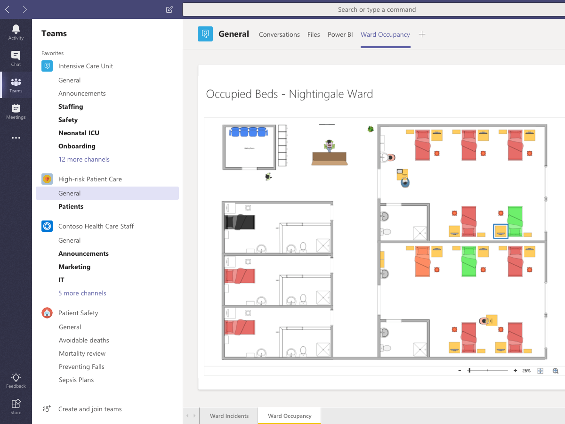




Microsoft Teams Tabs
Advantages on using SharePoint Framework as the UI implementation
Teams Solution
build with SharePoint Framework
Automated hosting
Automated hosting with optimized CDN
Easy access to Graph API
Easy Graph API access even without Azure admin UI configurations
Simple deployment
Simple centralized deployment
Reuse same implementation
One codebase to implement extensibility which works in multiple platforms
Notes:
Introduce Microsoft Teams as the problem solver. At a high level, talk about the full capabilities that Teams offers]
Microsoft Teams is a chat-based workspace where you can communicate effectively, collaborate efficiently, customize your environment and work in confidence.
[Speak through all pillars]
----------------------
[This is an animated slide. Please show it in presentation mode]
[MAIN POINT TO LAND]
And as you may already know, Microsoft Teams is the hub for teamwork, a chat-based workspace that enables teams to be more productive by giving them a single and secure location that brings together everything a team needs: chats, meetings, calls, files, and tools. Microsoft Teams is one place for all the needs your teams have.
Microsoft Teams delivers on four core promises to create a digital workspace for high performing teams.
[COMMUNICATE]
First, Microsoft Teams solves for the communication needs of a diverse workforce.
Since preview, Microsoft Teams has evolved to include a complete meetings experience, as well as chat, voice and video -
You can use Teams for informal 1:1 or group chats – directly on your phone if you’re on the go. Or you can have an open conversation in a channel. This enables people to share information in a transparent way to accelerate decision making. And it's super easy to move from a chat into a face to face meeting, helping you to bridge geographical barriers.
[COLLABORATE]
When it comes to collaboration, the deep Office integration enables today’s multigenerational workforce to use the Office apps they are familiar with and love - Word, Excel, PowerPoint, OneNote, SharePoint, Planner, even Power BI - right within the context of Teams. Teams is unique in how we enable collaboration.
Today, when you want somebody’s feedback, you send them the file via email, they store it locally with comments, you store it again…… it's a vicious cycle that results in v2, v3, v4 versions – and you have to jump between email and other apps to get the work done. Teams brings all the Office 365 services together – so that you can easily share and co-author files without the need for email attachments.
[CUSTOMIZE]
Many of you use other services than Office 365 as well which results in you having to jump between and spend time in disparate experiences. We built Teams to not only be the hub for Office 365 services, but for all the services and tools teams use on a day to day basis. So, you can customize Teams with tabs, connector and bots to include the apps and services you need - <mention relevant 3rd party apps like GitHub and Trello that can be included in Teams>– we have integrations with over 150 partners. For our developer community, we have also created an extensible platform, to enable building apps and to integrate with business processes.
[WORK WITH CONFIDENCE]
Microsoft Teams comes with the enterprise grade security, compliance and manageability that you expect from Office 365 which customers tell us is a huge value add for them.

Slide 24




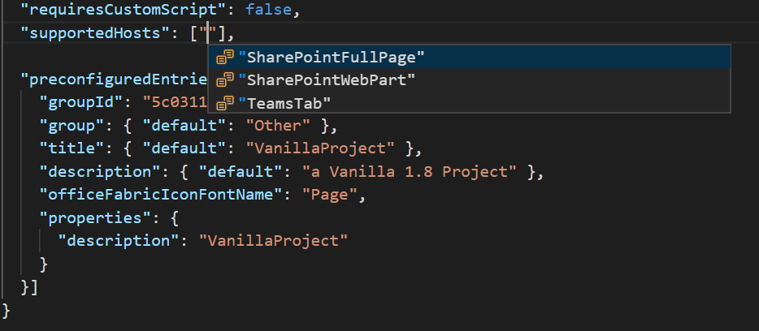
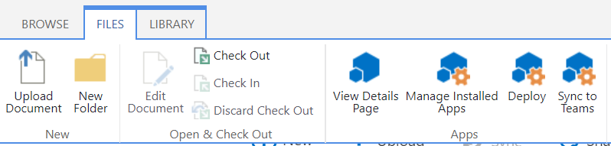
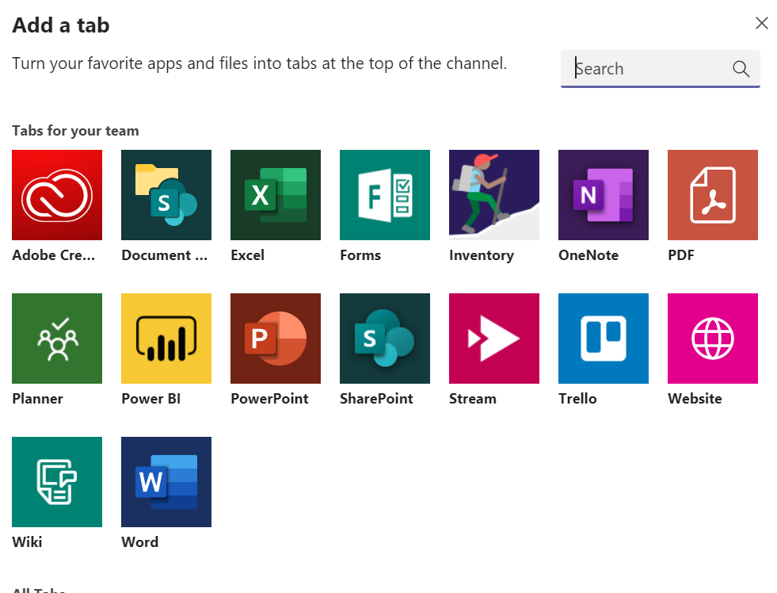
Develop Teams Tabs using SPFx
Enable developers to build SPFx based Tabs solutions
Full Teams context and SDK available at development and run time
Hosting, authentication, and API access handled by SharePoint directly
Full support for rich clients

Slide 25
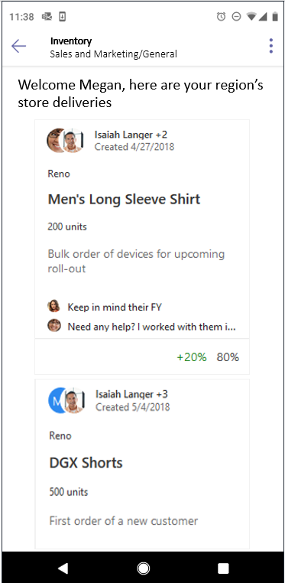
Building Tabs using SPFx Development Model
In design phase
Enable developers to build SPFx based Tabs solutions
Full Teams context and SDK available at development and run time
Hosting, authentication, and API access handled by SharePoint directly
Full support for rich clients

Slide 26
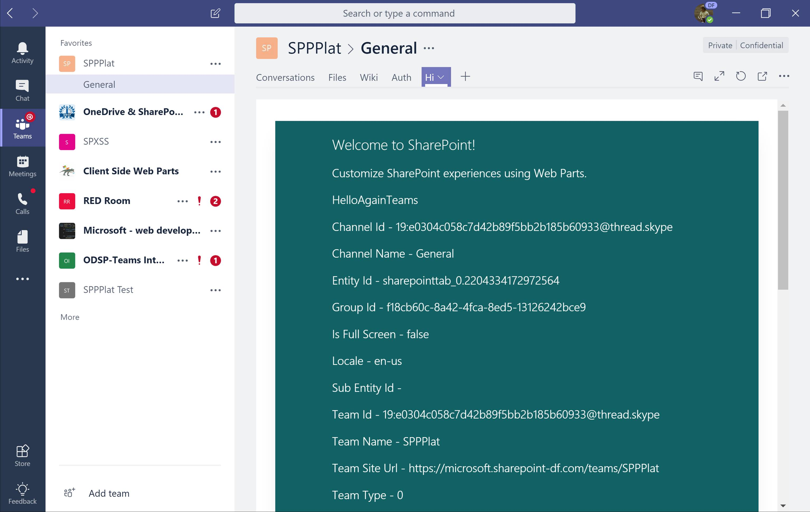
Building Tabs using SPFx Development Model
Office 365 public CDN
js
JavaScript Library
SharePoint Online
3
SPFx Teams Application
All typical configuration available as for any SPFx solution – like asset packaging, CDN configuration, asset provisioning etc.
js
SPFx solution
Tenant App catalog
SPFx Teams application exposed in the Microsoft Teams as a tab (IFrame). Assets are hosted in SharePoint and published to Teams using standard Teams model.
js
SPFx Teams solutions are deployed to Office 365 tenants using tenant app catalog- Typical options for the sppkg file packaging and hosting available.
JavaScript Library
2
1

Slide 27
Demo
Build Teams Tab using SharePoint Framework

Slide 28
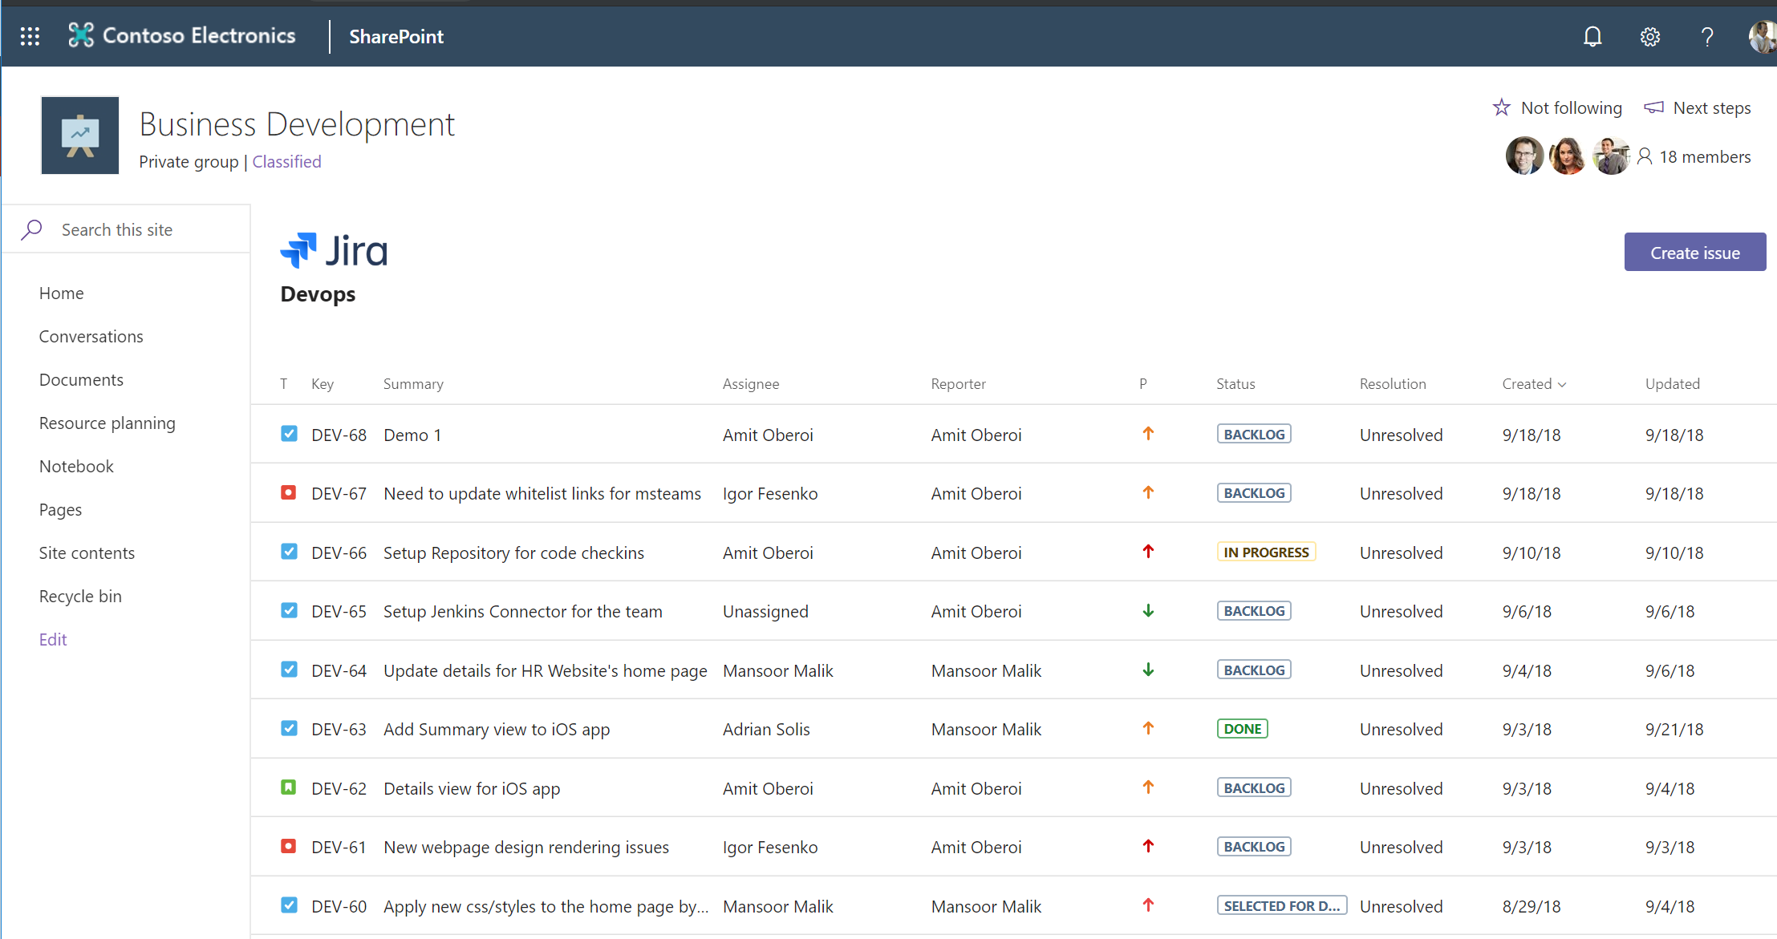
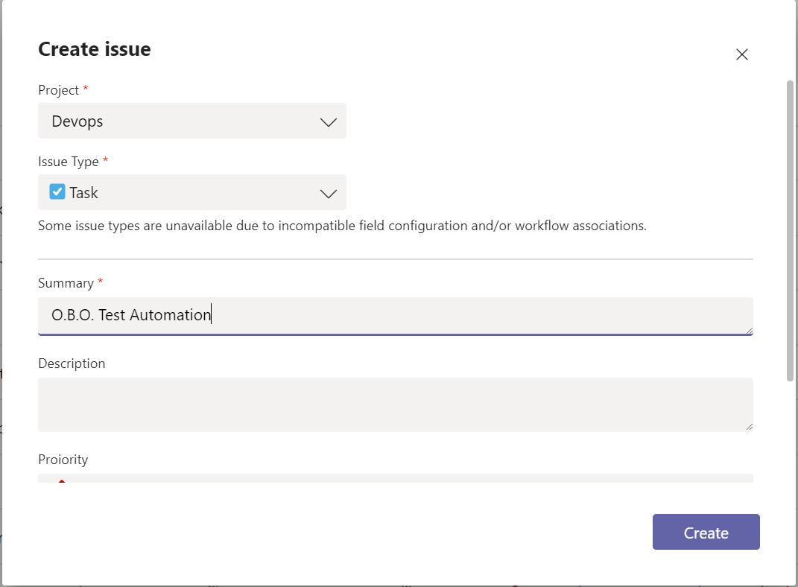
Tabs in SharePoint Pages
GA starting May onwards
Uses the same infrastructure / technology as the Microsoft Teams Tab
Even same package!
Logical successor to the existing SharePoint add-In model
A common development methodology for iFramed solutions
Supports both js/client solutions as well as traditional server-side solutions (.aspx/C# or even Java)

Slide 29
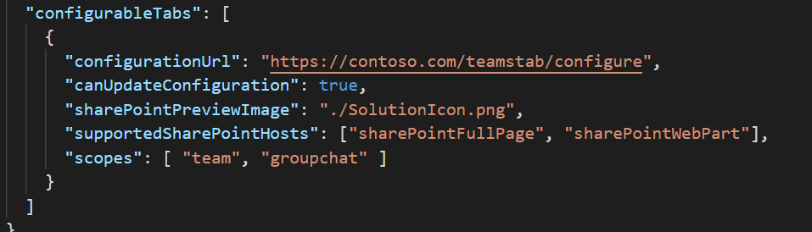
"Teams" Provider Hosted Solutions in SharePoint
Uses the same infrastructure / package as Microsoft Teams
Supported both as Web Part and App Page
Provides the SharePoint Page Context as part of the SDK
Requires minimal or no changes to existing solutions
Supports both js/client solutions as well as traditional server-side solutions (.Net / C# or even Python)

Slide 30
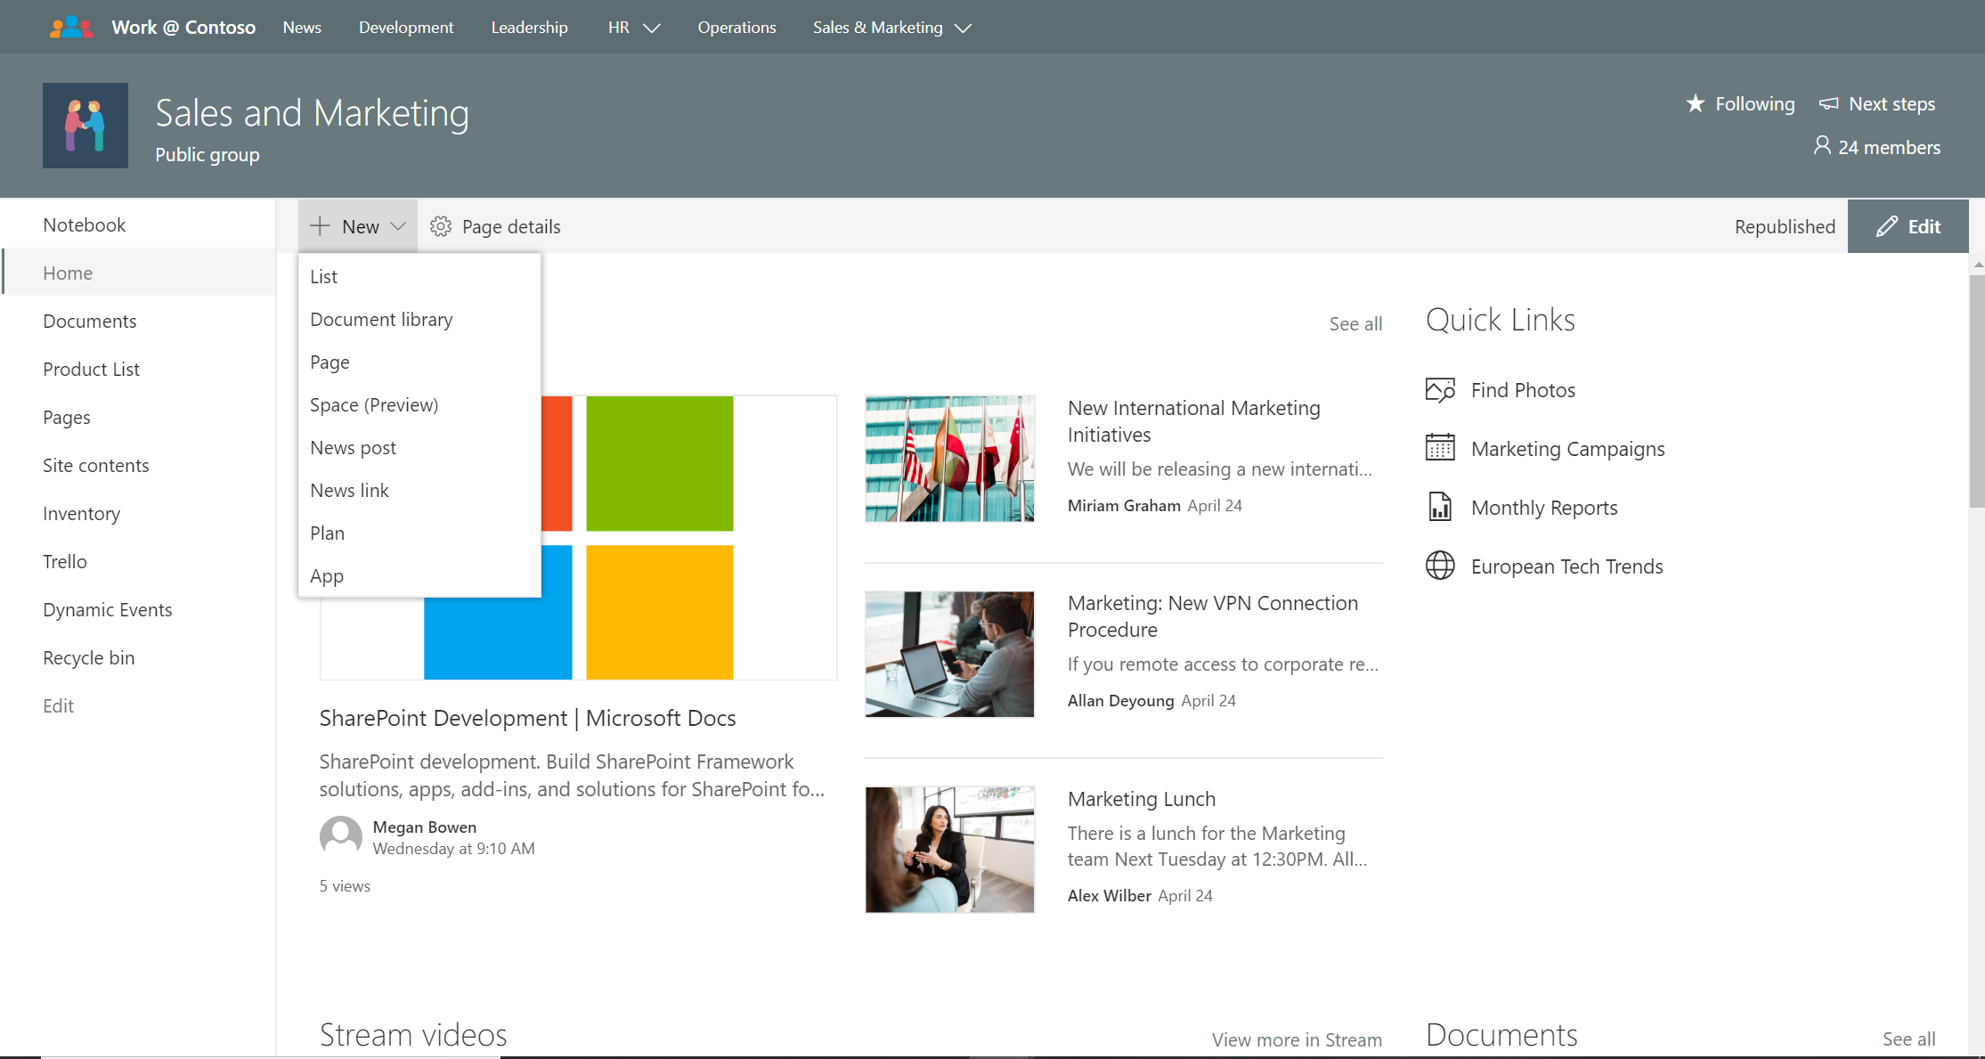
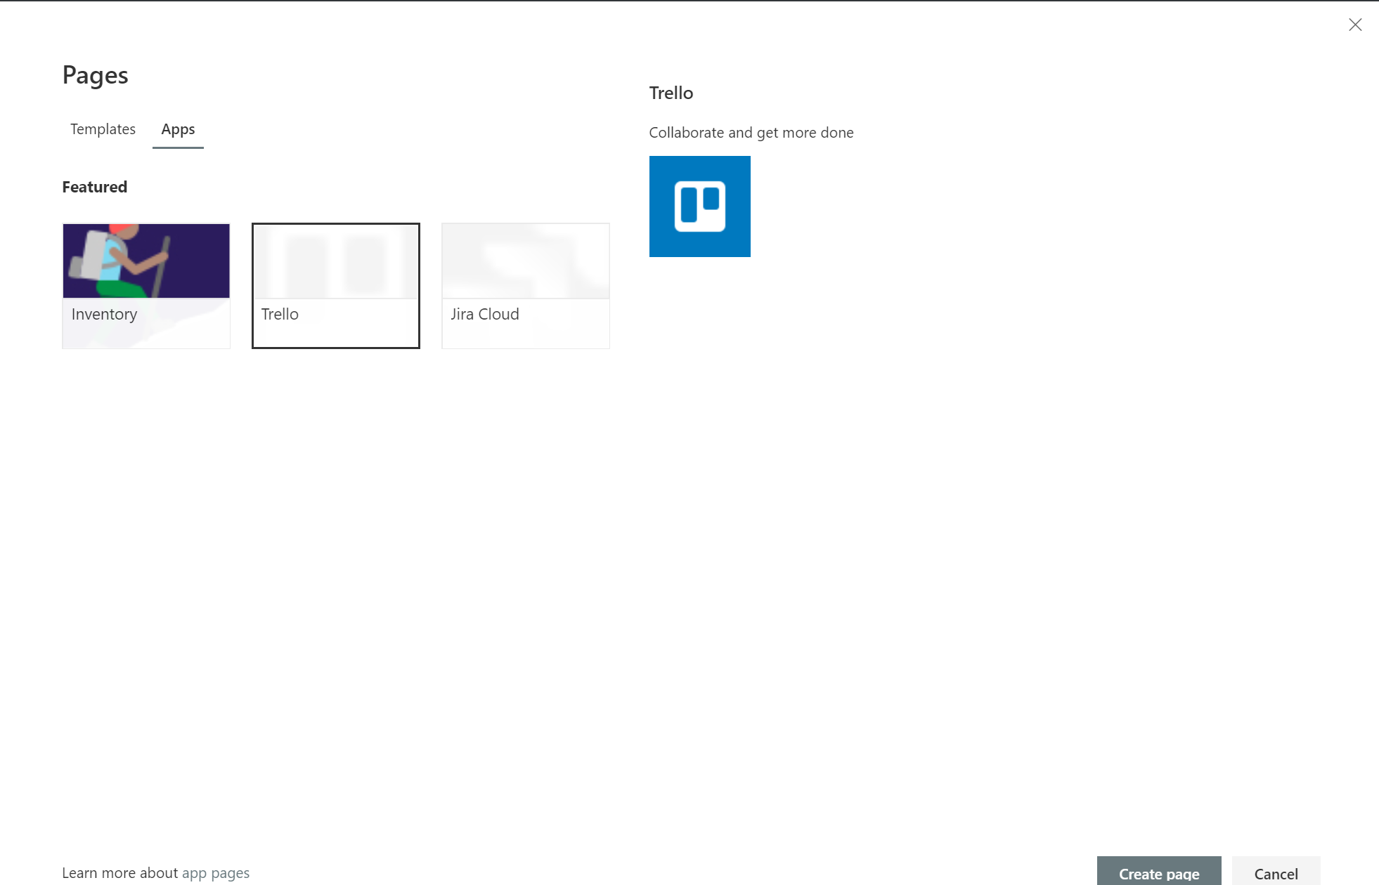

Slide 31
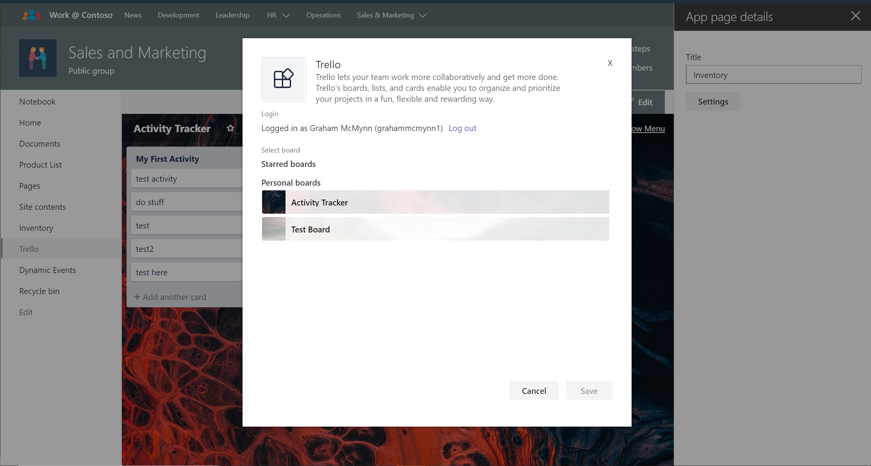

Slide 32
Tabs Development Models
Provider Hosted
SPFx
Ideal for surfacing existing solutions in multiple platforms
Works for personal and configurable tabs
Requires existing infrastructure (web APIs + rendering)
Ideal for building solution for Microsoft 365
Supports Teams, SharePoint… And more
Works for configurable tabs
Supports single sign-on on web and rich clients
Can leverage Office 365 infrastructure

Slide 33
Demo
Provided Hosted Tabs in SharePoint

Slide 34
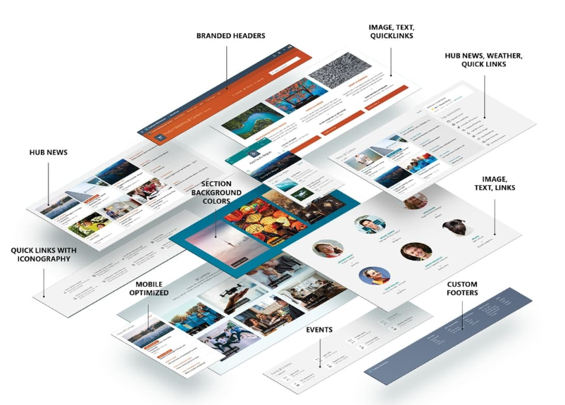
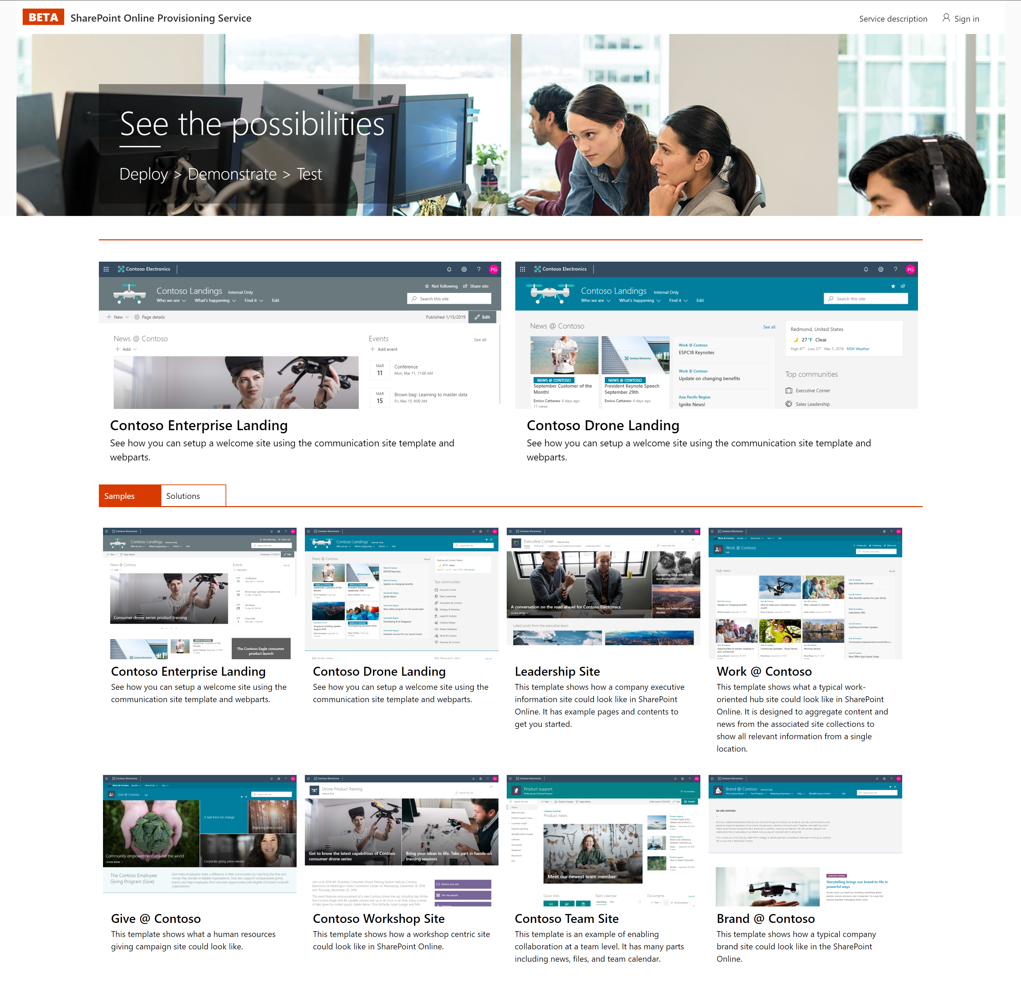
SharePoint Provisioning Service
http://aka.ms/spprovisioning
SharePoint Look Book
http://aka.ms/sharepointlookbook

Slide 35
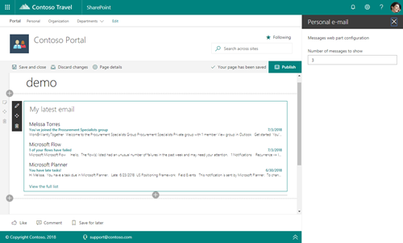
Domain Isolated Web Parts
Code runs in an auto-generated domain w/ different API permissions than the main tenant, and is iFramed into the main page
Same context as the hosting page
Framework handles AAD App registration and permission scopes and authentication
Support for Web Parts, App Pages and Teams tabs
Useful for a Web Part that needs extra permissions (mail.read) or a Web Part that wants extra protection (other parts can't access your back end data)
https://contoso-12345.sharepoint.com

Slide 36
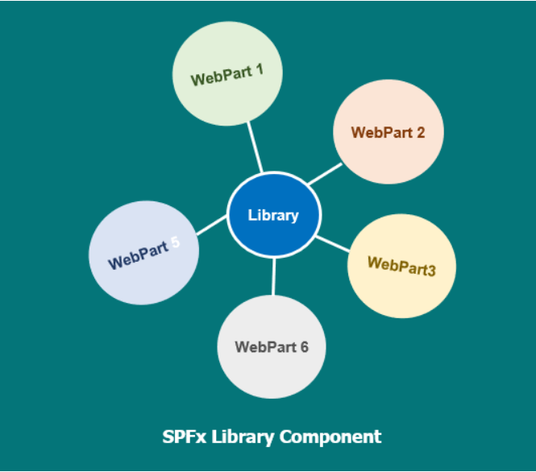
Library Components
Allow independently versioned deployed code, to be served automatically for the SharePoint Framework components

Slide 37
Library Components
Allow independently versioned deployed code, to be served automatically for the SharePoint Framework components
Libraries are deployed in the app catalog then they can be referenced across other components
Things to be aware of:
All components in the tenant get the same instance of the library
A solution cannot contain webparts/extensions and libraries. It’s one or the other
You must reference the library components at development time from a package manager or using npm link

Slide 38
Demo
Implementing library components for SharePoint Framework Webparts

Slide 39
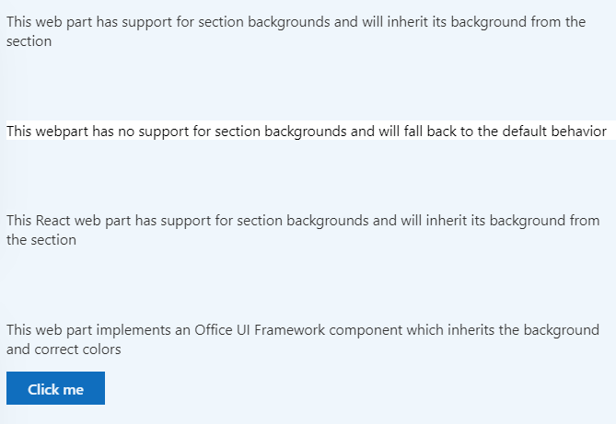
Supporting section backgrounds
Version 1.8 – Supports section backgrounds
SPFx web parts can be made aware of any section backgrounds
Improve the appearance of a web part when hosted in a section with a different background

Slide 40
Demo
Supporting section backgrounds for SharePoint Framework Web Parts

Slide 41
Office 365 CLI – Upgrade SharePoint Framework Project
Manage Microsoft Office 365 tenant and SharePoint Framework projects on any platform
spfx project upgrade
spfx project upgrade --toVersion 1.8.2 --output md > upgrade-report.md
Upgrades SharePoint Framework project to the specified version and save the findings in MarkDown file
Reference:
https://pnp.github.io/office365-cli/
https://pnp.github.io/office365-cli/cmd/spfx/project/project-upgrade/

Slide 42
Latest OOTB Capabilities – Modern Web Parts
Button Web Part
Call to Action Web Part
World Clock Web Part
Countdown Timer Web Part
Duplicate section or web part

Slide 43
MS Ignite 2019 Updates

Slide 44



The Road Ahead – SPFx 1.10 Release
ETA CY 2019
(subject to change)
Extensions: Pre-allocated placeholders
SPFx for Teams –personal apps support
SPFx for Teams – support for mobile app
List notification API moved to GA
Developer Preview
New extension: Query Modification
SPFx for Office – support for Office add-ins (starts with OWA)

Slide 45
1.10 Feature Set
Pre-allocated placeholders
Supported for both top and bottom placeholders
Doesn’t add additional delay in loading
Supported in existing extensions: manifest update is the only required change
SPFx for Teams –personal apps support
Supports all the SPFx capabilities: context information, access to Graph and other Web APIs, etc.
No configuration support
Same “sync to Teams” experience via SharePoint App Catalog
Supports admin management via app policies
SPFx for Teams – support for mobile app
SPFx based tabs supported in the native mobile app
Both for personal apps and channel tabs
Available with the November release of Teams Mobile app

Slide 46
The Road Ahead – SPFx 1.10 Release
ETA CY 2020
Native support for Fluid Framework
SPFx support in store (AppSource)
Unified toolchain for Microsoft365 workloads
Faster inner dev loop
More extensions!

Slide 47
Roadmap: Developer platform
Available soon
Early next year
Top of mind
SharePoint Framework
Pre-allocated headers
Support for Teams personal apps
Support for Teams mobile app
Query Extensions (dev preview)
Support for Office add-ins in OWA (dev preview)
Fluid Components support (Private Preview)
Graph
Webhook support for Lists
Permission change support for Delta API
Followed Sites API (Dev Preview)
Check in \ Check out (Dev Preview)
SharePoint Framework
SPFx solutions in AppSource
GA of Query Extensions
Nav and header extensions (dev preview)
Graph
Site Discover\Enumeration API
File Requests Sharing API
Taxonomy API (dev preview)
Hub Analytics API (Dev Preview)
SharePoint Framework
Unified toolchain for Microsoft 365 workloads
Support for Fluid Components
Graph
CSOM on .NET Code

Slide 48
Flexible solutions for everyone
Authors
Makers
Low-code developers
Pro developers
Sites
Pages
List and libraries
Web parts
Microsoft Forms
Lists Conditional Formatting
Business Automation using Flows
Out of the box Flows
Connected web parts
Power BI
PowerApps
Adaptive Cards
List Formatters
Microsoft Graph
SharePoint Framework
Azure AI + Machine Learning
Azure Containers
Azure Bot Framework
It’s animated, so careful on edits

Slide 49
Learn
Reuse
Share
aka.ms/sppnp

Slide 50
SharePoint Development
Getting started
1
2
3
Build SharePoint Framework extensibility
Explore Patterns and Practices open-source assets
Extend and integrate with Microsoft ecosystem
Sign up for the Office 365 Dev Program - https://aka.ms/offdp

Slide 51
All New! training, certification and tools
For Microsoft 365 developers
You can find Microsoft 365 developer training modules on Microsoft Learn!
https://aka.ms/M365DevTraining
Free for Ignite 2019 participants!
Become Microsoft 365 Certified! Earn a Developer Associate certification
Exam MS-600: Building Applications and Solutions with Microsoft 365 Core Services (beta)
Get 80% off during beta period - receive full credit!
Join the Office 365 Developer Program! Get the new Microsoft 365 E5 dev subscription, sample data packs and more great tools
https://aka.ms/IgniteO365DevProgram

Slide 52


Thank you.

Slide 53

Enjoy the Bootcamp

Slide 54

Call to action
Share your feedback on Bootcamp at https://aka.ms/Microsoft365DevBootcampSurvey2019
Join Office 365 developer program https://dev.office.com/devprogram to leverage all resources for Office 365 development learning
Build applications on Office 365 platform
Attend MVP led local community events to continue learning on Office 365 development

